Slide 1
Lunch and Learn:
Environmental Review of Commercial Real Estate
Community Capital Development Corporation
5475 Rings Road
Dublin, OH
R. Curtis Spence, PE
Spence Environmental Consulting, Inc.
January 20, 2026

Slide 2
What is Environmental Risk?
Carcinogenic (cancer causing) and non-carcinogenic (damage to the liver, kidneys, nervous system, and respiratory tract, and developmental issues) risk from exposures to chemical contaminants in the air, water, and soil.
Exposure pathways include inhalation, ingestion and dermal contact.
  Inhalation of contaminated air (vapor intrusion into structures).
  Ingestion of contaminated groundwater.
  Dermal contact with contaminated soil.
Carcinogenic and non-carcinogenic risk may be isolated to the immediate location of the chemical contaminants (i.e., spill location) or may extend miles from the source area (groundwater contaminant plume).

Slide 3
What is Excessive Environmental Risk?
Concentrations of chemical contaminants in soil, groundwater and indoor air exceed standards published by the U.S. EPA, Ohio EPA Voluntary Action Program (VAP), and Ohio Bureau of Underground Storage Tank Regulations (BUSTR). Standards are typically based on 1 in 100,000 excessive cancer risk and a cumulative hazard quotient of 1 for non-carcinogenic risk.
Standards are published for both residential and commercial exposure scenarios and are typically based on 30 years of exposure.
Site specific standards or target levels can also be developed following procedures published by the U.S. EPA, Ohio EPA and BUSTR.

Slide 4
Mitigation of Excessive Environmental Risk
Source removal (soil excavation and groundwater extraction).
Contaminant reduction to acceptable concentrations through treatment including: chemical oxidation, biological treatment; activated carbon adsorption; and thermal processes. Includes in situ and ex situ treatment.
Engineering controls to prevent exposures including: vapor intrusion barriers; sub-slab depressurization; clean soil cover; and paved surfaces.
Environmental covenants (deed restrictions) prohibiting residential use, potable use of groundwater, etc.

Slide 5
Evaluating Environmental Risk
Step 1: Perform an assessment to determine if the subject property has the potential for excessive environmental risk. This includes the presence, likely presence or material threat of a release of hazardous substances and petroleum products.
SBA Records Search with Risk Assessment (SBA SOP 50 10 8)
(Apparent Low Risk Sites – not Environmentally Sensitive per Appendix 6 in SBA SOP 50 10 8)
Environmental Transaction Screen (ASTM E1528-22)
(Sites where CERCLA liability protection is not desired)
Phase I Environmental Site Assessment (ASTM E1527-23)
(Industry standard for “All Appropriate Inquiry under U.S. EPA Brownfield Program” including CERCLA liability protection)

Slide 9
Evaluating Environmental Risk
State and Federal Environmental Databases (1980’s to Present)
  Superfund Sites (National Priorities List) and other CERCLA (Comprehensive Environmental Response, Compensation, and Liability Act) Sites (1.0 and 0.5 Miles)
  Hazardous Waste (RCRA) Corrective Action, TSD, and Generator Sites (1.0 and 0.5 Miles and Subject and Adjoining Properties)
  Emergency Response Notification System (Subject Property)
  Landfills and Solid Waste Facilities (0.5 Miles)
  Leaking Underground Storage Tank Sites (0.5 Miles)
  Registered Underground Storage Tank Sites (Subject and Adjoining Properties)
  Voluntary Action Program Sites (0.5 Miles)
  Federal and State Institutional and Engineering Control Registries (Subject Property)
Historical Records (First Developed Use to Present)
  Historical Aerial Photography
  City Directory Records
  Fire Insurance Maps
  Historical Topographic Maps

Slide 10
Evaluating Environmental Risk
Interviews:
  Site Owner
  Site Occupants or Managers
  Local Government Officials
    Fire Department
    Health Department
    Building Department
    Local Trustees or Zoning Officers
Site Features:
  Topography
  Geology and Hydrogeology
Site Inspection:
  Current Site Usage and Development
  Use of Hazardous Substances and Petroleum Products
  Visible Evidence of Historical Usage
  Housekeeping and Engineering Controls
  Adjacent/Nearby Site Usage

Slide 11
Phase I Environmental Site Assessment
(ASTM E1527-23)
Environmental Database
Historical Records
Interviews of Past and Present Owners and Occupants via Questionnaires
Interview/Questionnaire of Report User for Prior Site Knowledge, Environmental Liens, Use Limitations, Environmental Impact on Sale Price
Interviews of Local Public Officials
Visual Inspection of Subject Site and Adjoining Properties (Photo Documentation)
Detailed Report of Collected Data and Identification of RECs, CRECs, HRECs, and BERs.
Non-Scope Considerations including Asbestos, Wetlands, Mold, Lead-Based Paint, and Lead in Drinking Water may be added to the Scope of Work.

Slide 12
SBA Gasoline Station Loans
Per SBA SOP 50 10 8, Appendix 7, the following work must be completed.
  Phase I Environmental Site Assessment
  UST Records including BUSTR Registration, PUSTRCB Insurance Certificate, Compliance Inspections and Testing Records
  Repair or Replacement of any Failed, Leaking or otherwise Defective Equipment
  Phase II Environmental Site Assessment (if required)

Slide 13
What are the Findings of an Environmental Assessment?
SBA RS/RA: Low, Elevated or High Risk
Transaction Screen: Potential Environmental Concerns
Phase I ESA: REC, CREC, HREC, BER

Slide 14
Recognized Environmental Condition (REC)
A Recognized Environmental Condition (REC) is:
  The presence of hazardous substances or petroleum products in, on, or at the subject property due to a release to the environment;
  The likely presence of hazardous substances or petroleum products in, on, or at the subject property due to a release or likely release to the environment; or
  The presence of hazardous substances or petroleum products in, on, or at the subject property under conditions that pose a material threat of a future release to the environment.
.

Slide 15
Recognized Environmental Condition (REC)
Potential RECs:
  Use or Storage of Hazardous Materials or Petroleum Products
  Underground and Aboveground Storage Tanks
  Dry Cleaning
  Underground Hydraulic Lifts
  Manufacturing Facilities
  Wood Finishing
  Metal Plating
  Chemical Manufacturing and Distribution
  Known Spills
  Hazardous Waste Generators
  Solid Waste Disposal

Slide 16
Controlled Recognized Environmental Condition (CREC)
A Controlled Recognized Environmental Condition (CREC) is a REC at the subject property that has been addressed to the satisfaction of the applicable regulatory authority or authorities with hazardous substances or petroleum products allowed to remain in place subject to implementation of required controls. In the case of self-directed actions, documentation that the REC satisfies risk-based criteria established by the applicable regulatory authority or authorities.
A past release that previously qualified as a CREC may no longer constitute a CREC if new conditions or information have been identified such as a change in regulatory criteria, a change of use at the subject property, or a subsequently identified migration pathway that was not previously known or evaluated.

Slide 17
Historical Recognized Environmental Condition (HREC)
A Historical Recognized Environmental Condition (HREC) is a previous release of hazardous substances or petroleum products affecting the subject property that has been addressed to the satisfaction of the applicable regulatory authority or authorities and meeting unrestricted use criteria established by the applicable regulatory authority or authorities without subjecting the subject property to any controls (for example, activity and use limitations or other property use limitations). A HREC is not a REC.
A past release that qualified as a HREC may no longer qualify as a HREC if new conditions or information have been identified such as a change in regulatory criteria or a subsequently identified migration pathway that was not previously known or evaluated.

Slide 18
Business Environmental Risk (BER)
A Business Environmental Risk (BER) is a risk which can have a material environmental or environmentally-driven impact on the business associated with the current or planned use of commercial real estate, not necessarily related to those environmental issues required to be investigated in this practice.
A BER may include hazardous substances and petroleum products storage and use, asbestos, wetlands, lead-based paint, and environmental compliance concerns.

Slide 19
Recognized Environmental Condition (REC)
Environmental Databases

Slide 20
Recognized Environmental Condition (REC)
Environmental Databases

Slide 21
Recognized Environmental Condition (REC)
City Directories
1959 1999

Slide 22
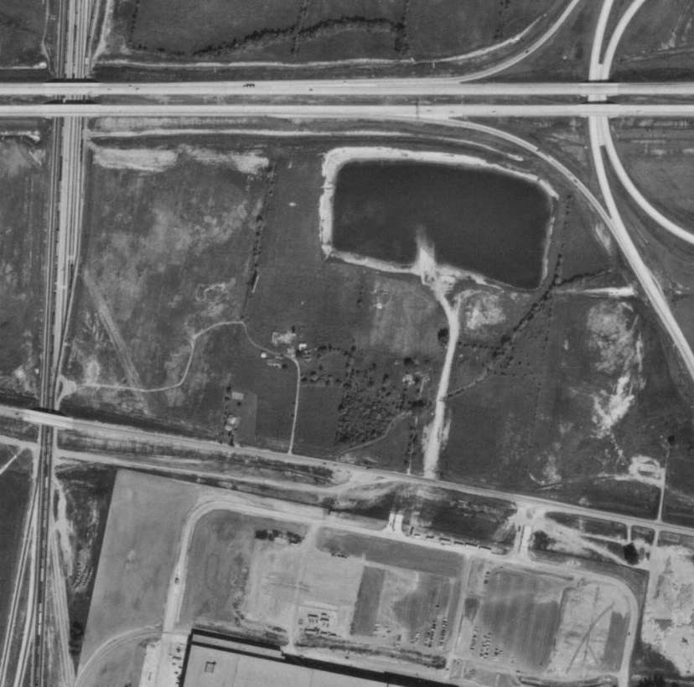
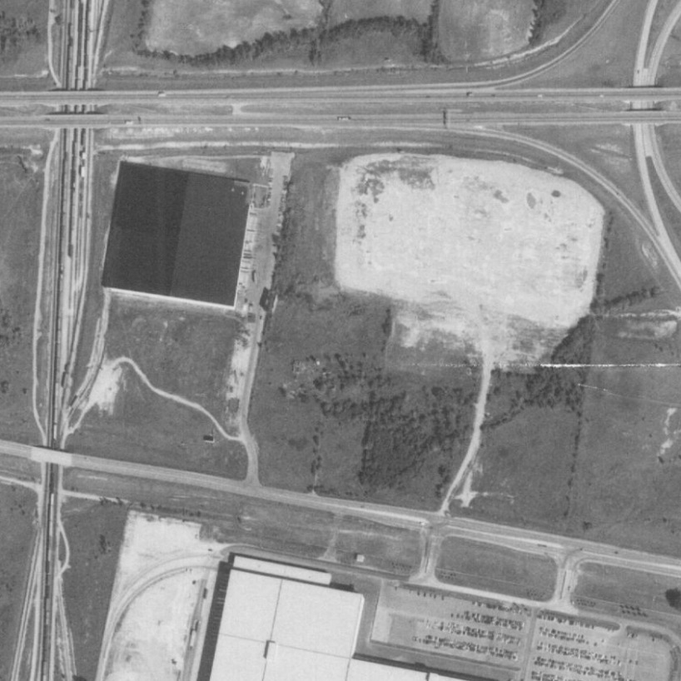
Recognized Environmental Condition (REC)
Aerial Photographs
1971 1980

Slide 23
Recognized Environmental Condition (REC)
Sanborn™ Fire Insurance Maps

Slide 24
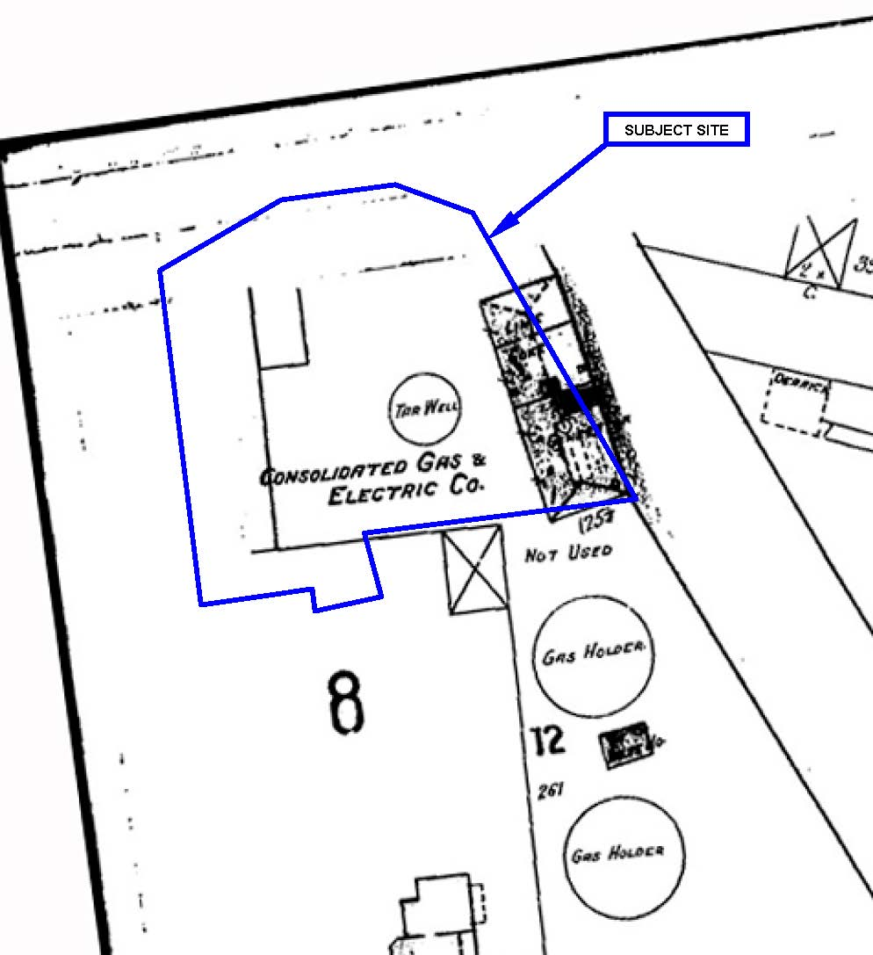
Recognized Environmental Condition (REC)
Sanborn™ Fire Insurance Maps
(1896 to 1914)

Slide 25
Phase II Environmental Site Assessments
Step 2: Determine if a Recognized Environmental Condition (REC) has resulted in excessive environmental risk.
Collect soil vapor, indoor air, soil, and groundwater samples and analyze collected samples for the chemicals of concern associated with the identified hazardous substances and/or petroleum products.
Common equipment used during a Phase II ESA include sub-slab and indoor air sampling equipment (vapor pins and summa canisters), soil sampling equipment (hydraulic sampling probe), groundwater monitoring wells, ground-penetrating radar, electromagnetic instruments, and hand sampling equipment.

Slide 26
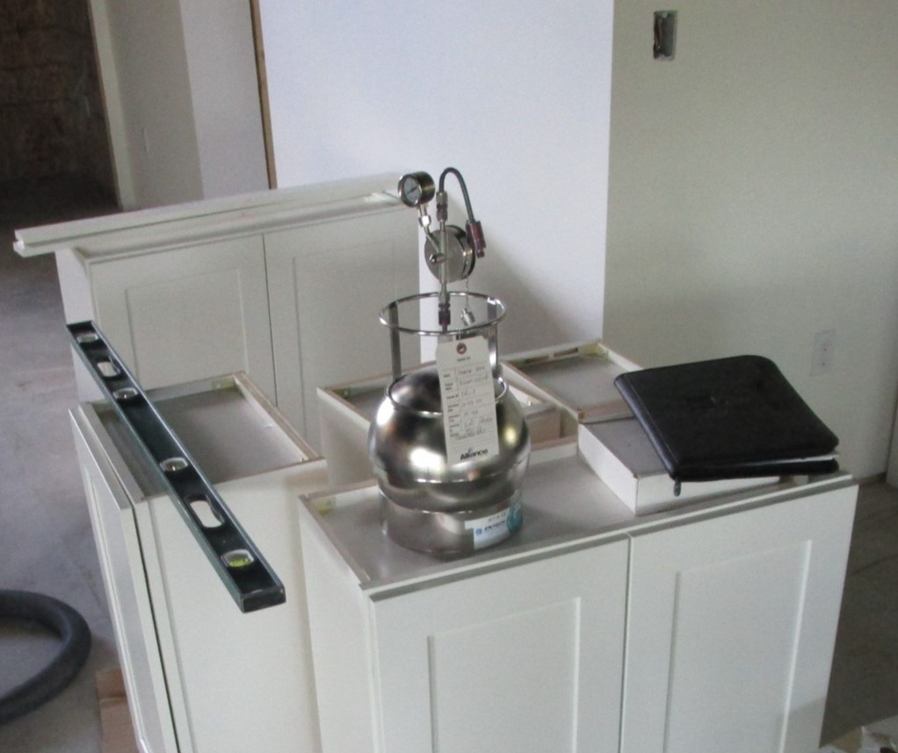
Indoor Air Sampling

Slide 27
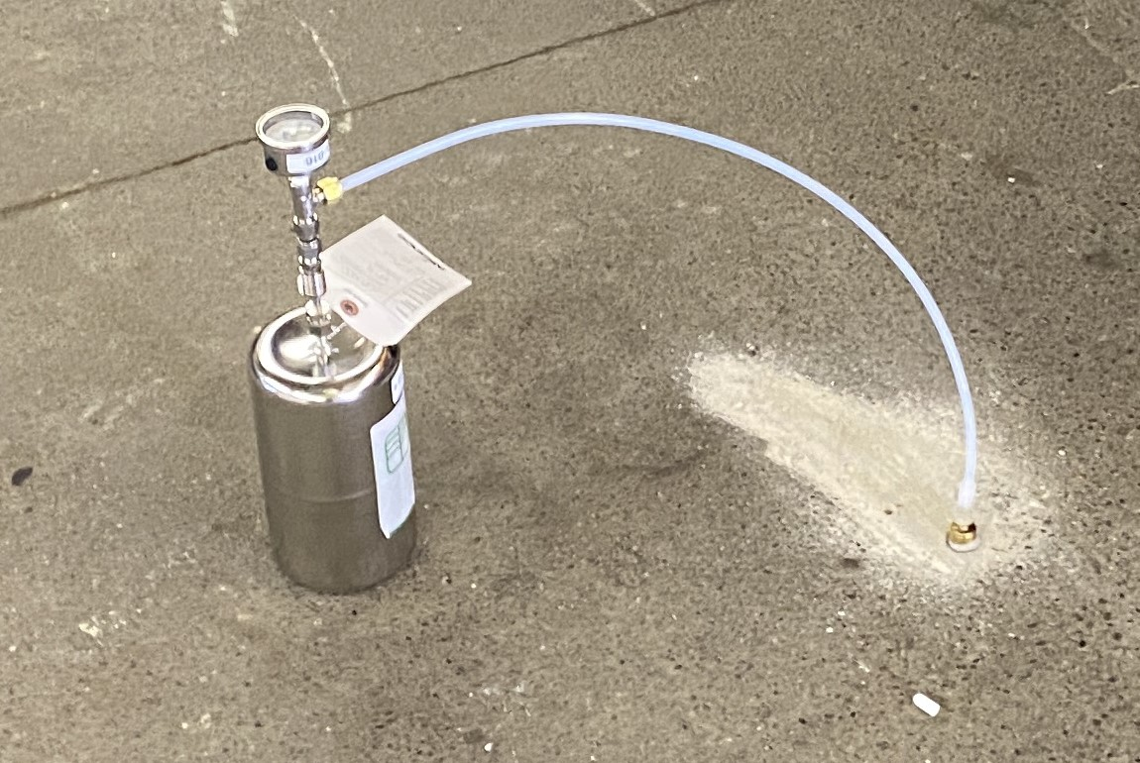
Sub-Slab Soil Vapor Sampling

Slide 28
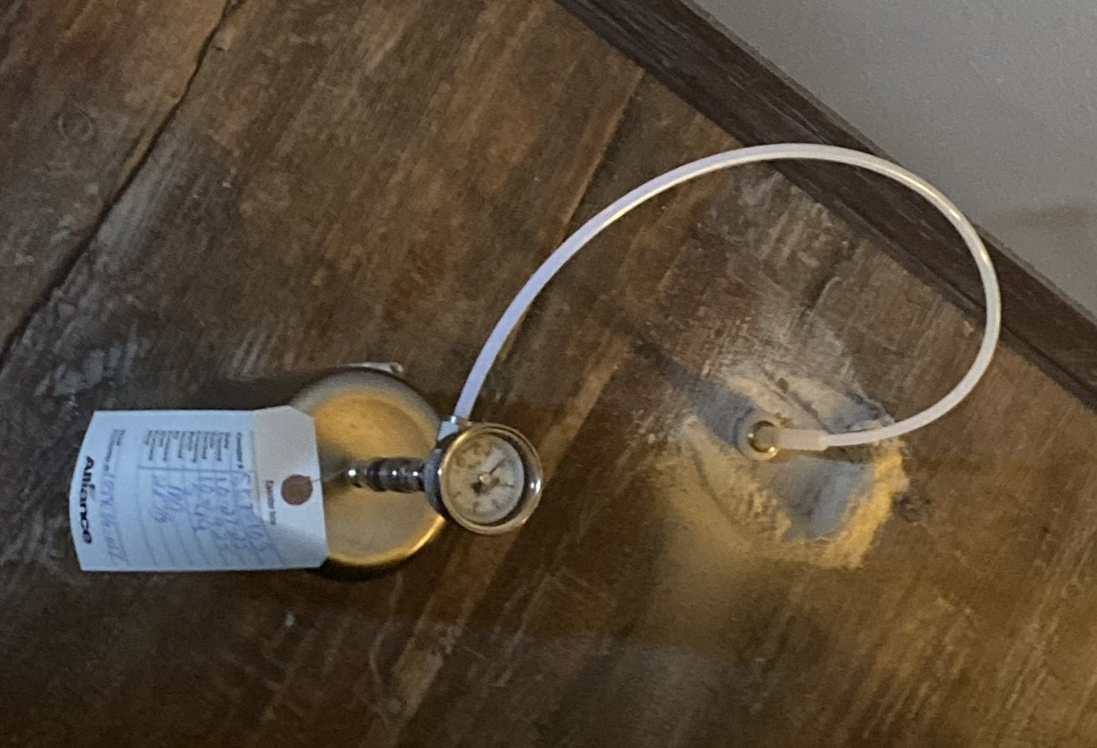
Sub-Slab Soil Vapor Sampling

Slide 29
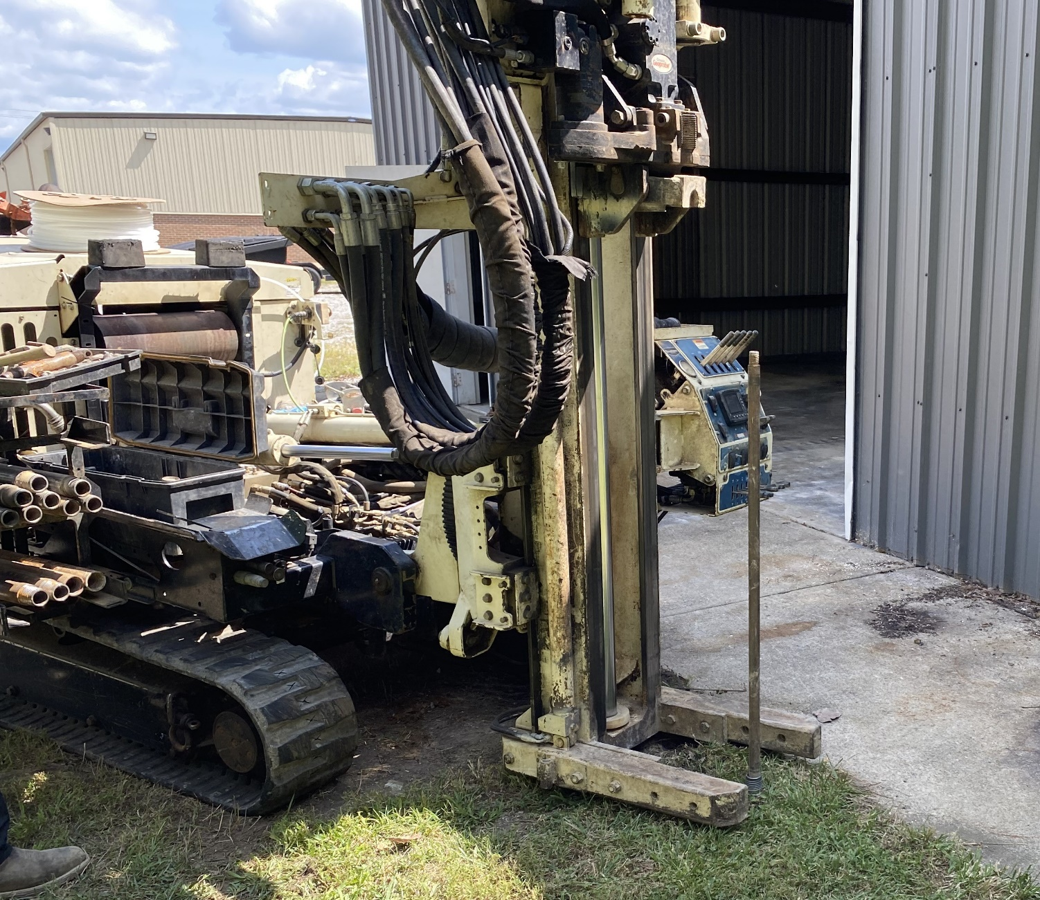
Hydraulic Sampling Probe

Slide 30
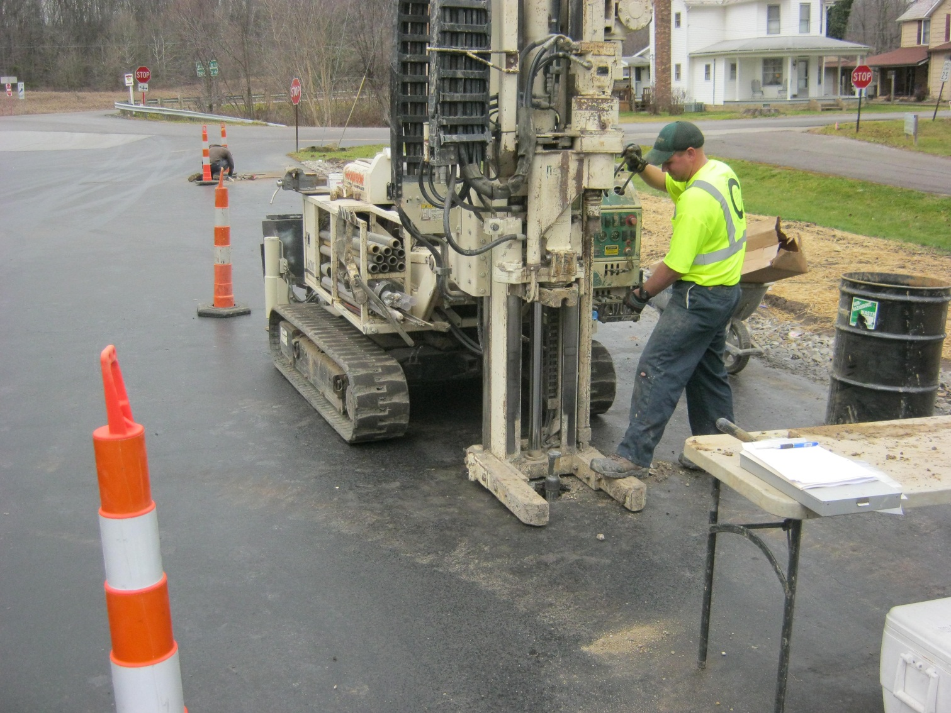
Hydraulic Sampling Probe

Slide 31
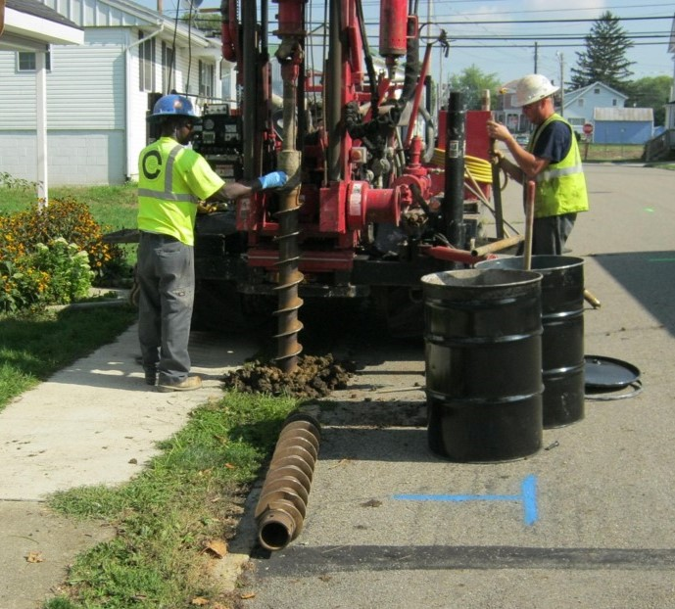
Rotary Drill Rig

Slide 32
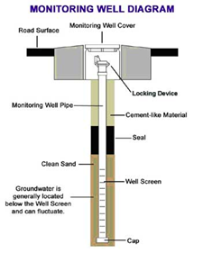
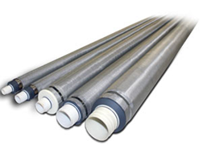
Groundwater Monitoring Wells

Slide 33
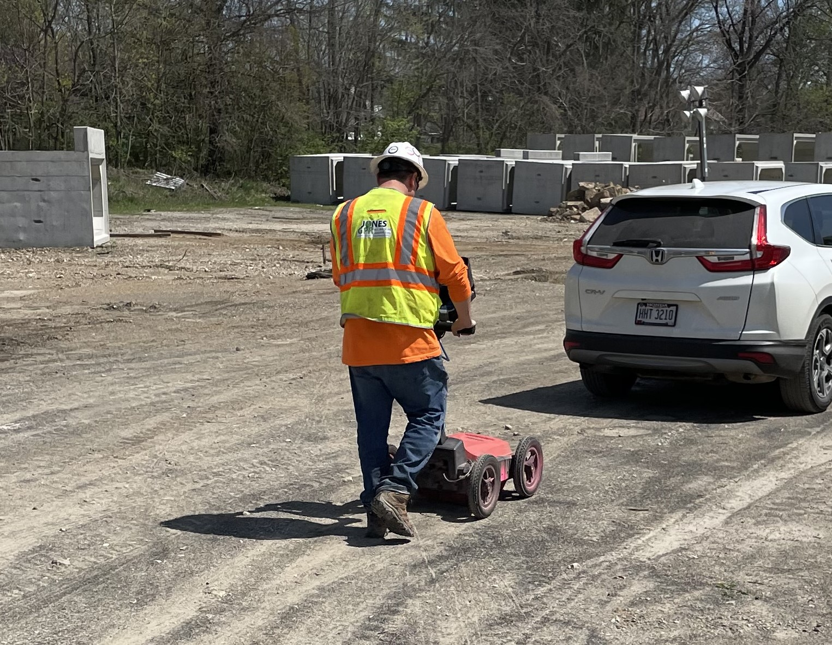
Ground Penetrating Radar

Slide 34
Ground Penetrating Radar

Slide 35
How are Leaking Underground Storage Tank Sites in Ohio Evaluated?
(BUSTR Corrective Action)
Required if a release is suspected or confirmed at a BUSTR regulated underground storage tank site.
Tier 1 Evaluation: Site assessment to define the extent of soil and groundwater impacts similar to a Phase II ESA except permanent groundwater monitoring wells are required.
Tier 2 Evaluation: Environmental risk assessment including evaluation of: groundwater fate and transport; soil to groundwater leaching; and soil and groundwater to indoor air exposure pathways.
A Remedial Action Plan is prepared after the Tier 2 Evaluation and may include soil and/or groundwater remediation.

Slide 36
Site Remediation
Goal: Lower environmental risk to acceptable levels (below generic published standards or site specific target levels)
Soil: Landfilling, Bioremediation, Vapor Extraction, Chemical Oxidation, Thermal Oxidation, Stabilization
Groundwater: Extraction and Off-Site Treatment, Carbon Adsorption, Air Stripping, Bioremediation, Chemical Oxidation, Natural Attenuation, Reactive Barriers
Soil Vapors: Vapor Extraction
Land Use Restrictions: No Groundwater Use, No Residential Use, No Basements, No Excavations
Engineering Controls: Vapor Intrusion Barrier, Sub-Slab Depressurization, Pavement, Clean Soil Cover

Slide 37
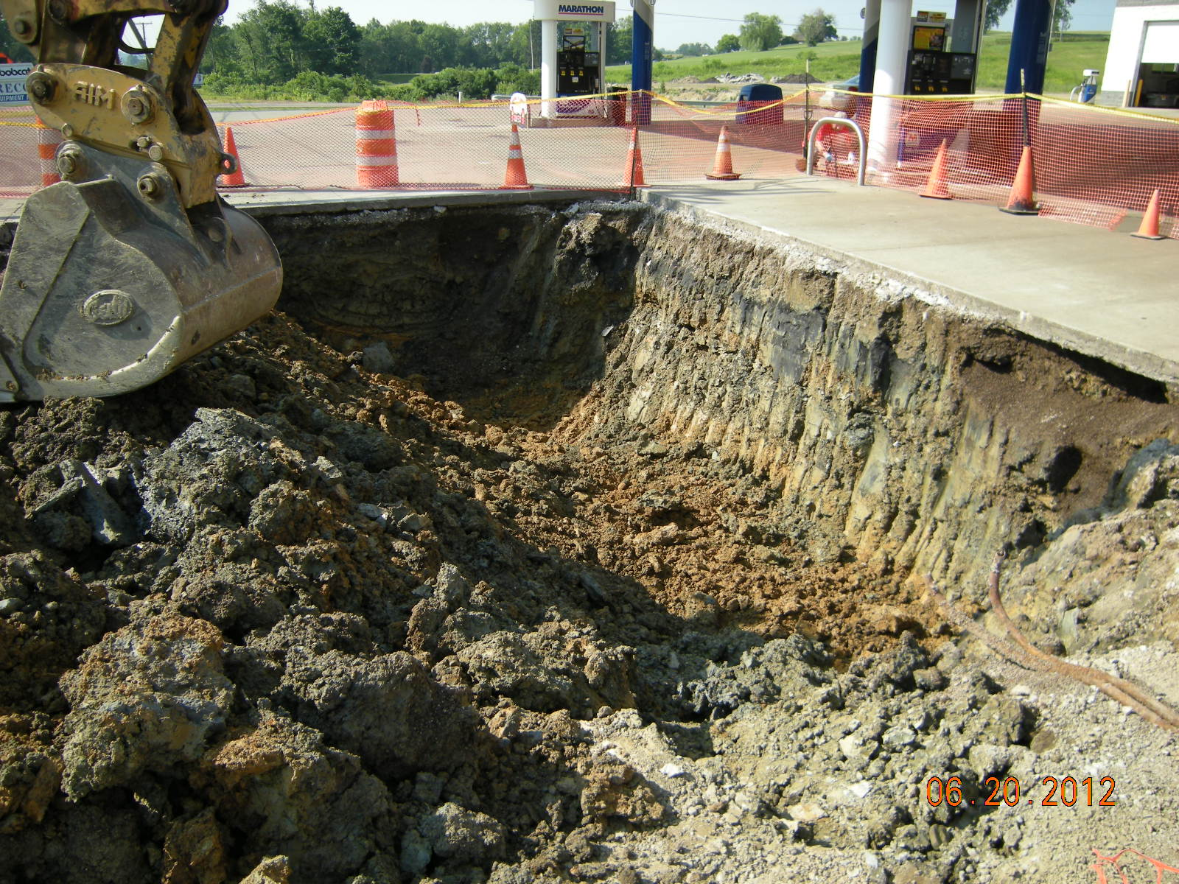
Soil Excavation and Disposal

Slide 38
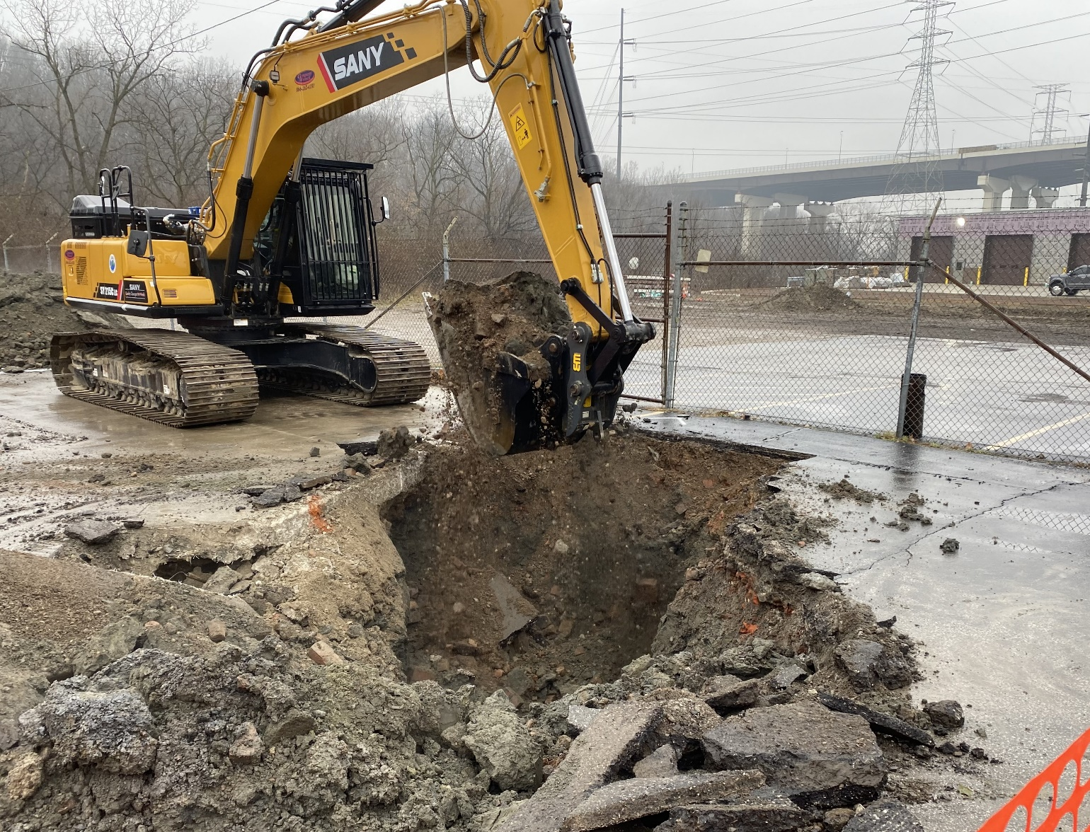
Soil Excavation and Disposal

Slide 39
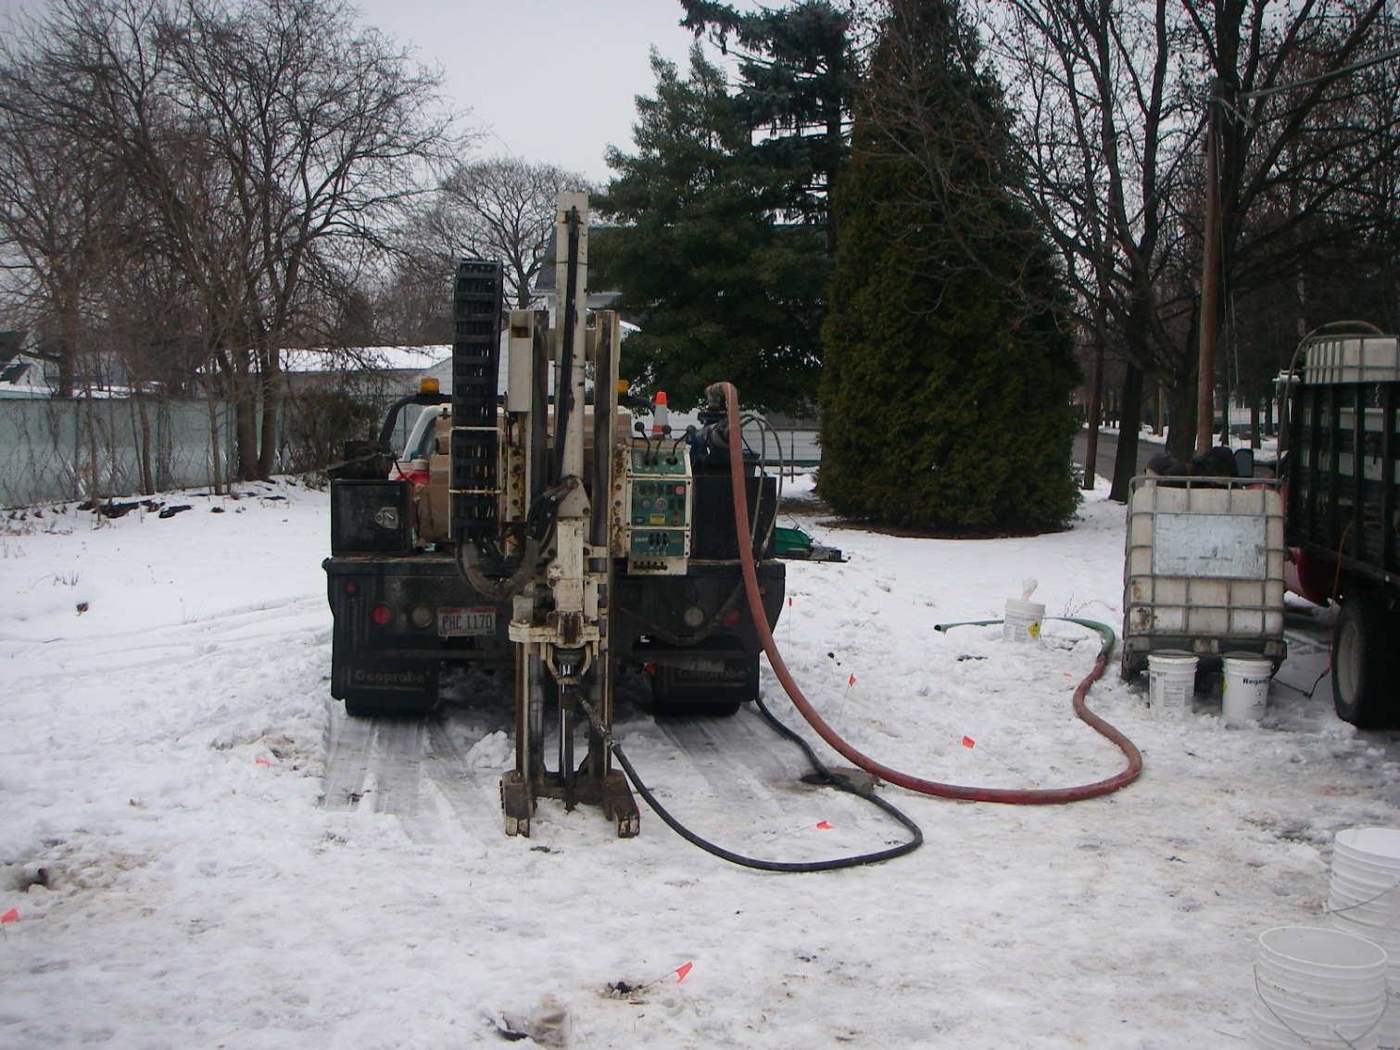
Chemical Oxidation and Bioremediation

Slide 40
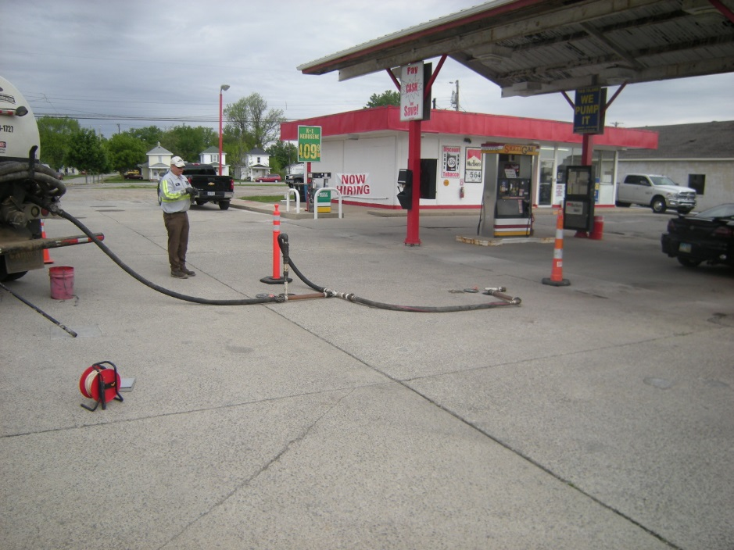
Enhanced Fluid Recovery (EFR)

Slide 41
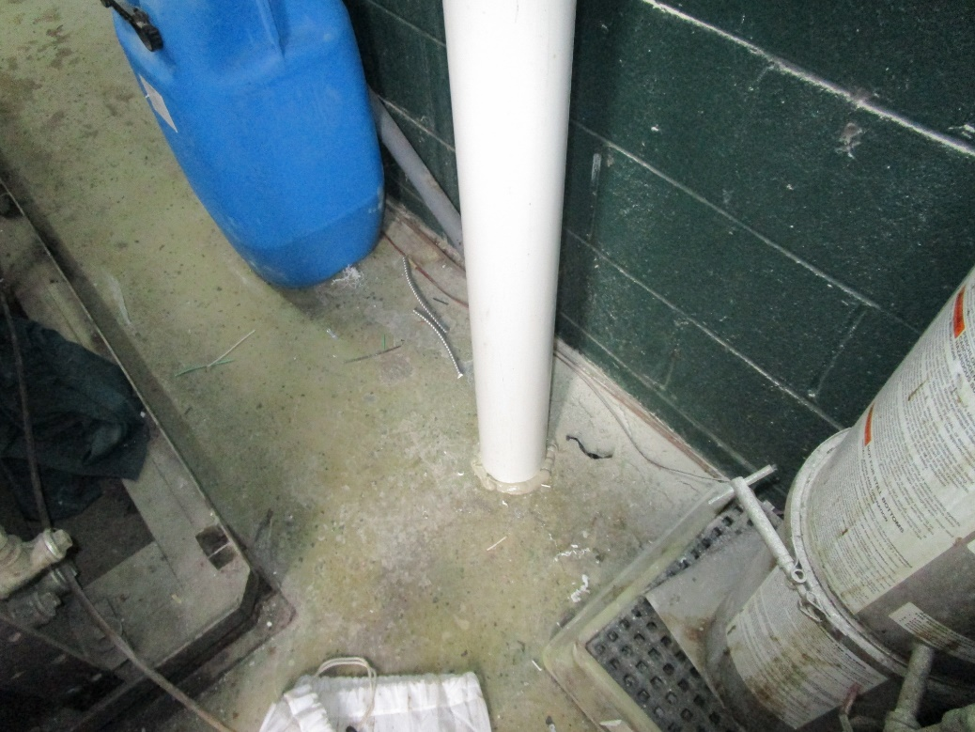
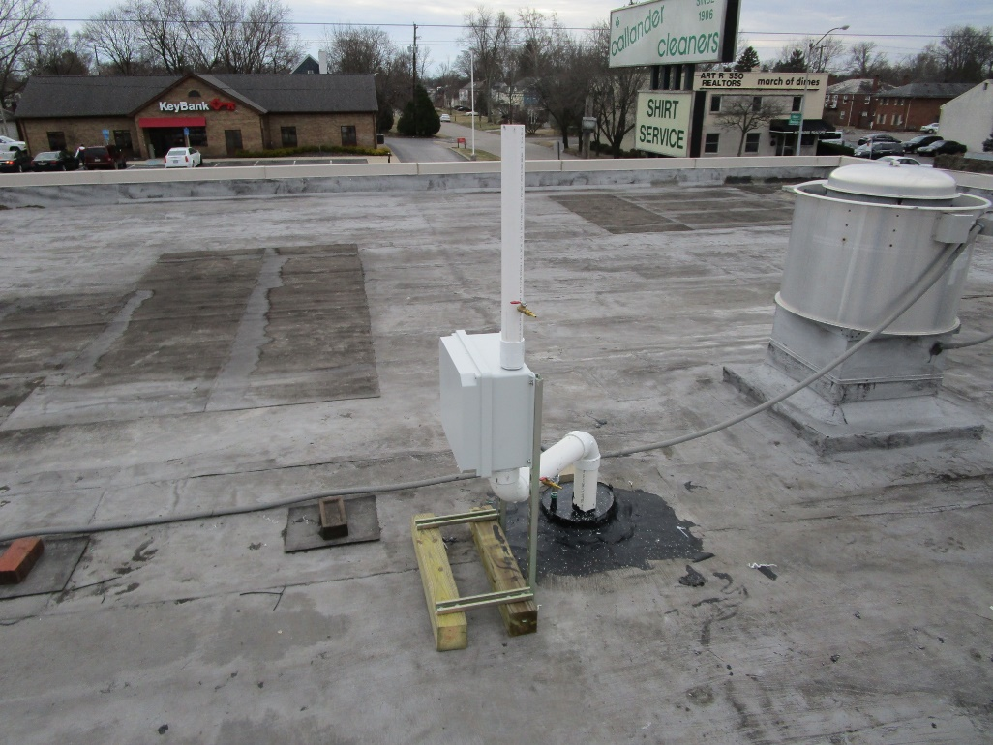
Sub-Slab Vapor Intrusion
Mitigation System

Slide 42
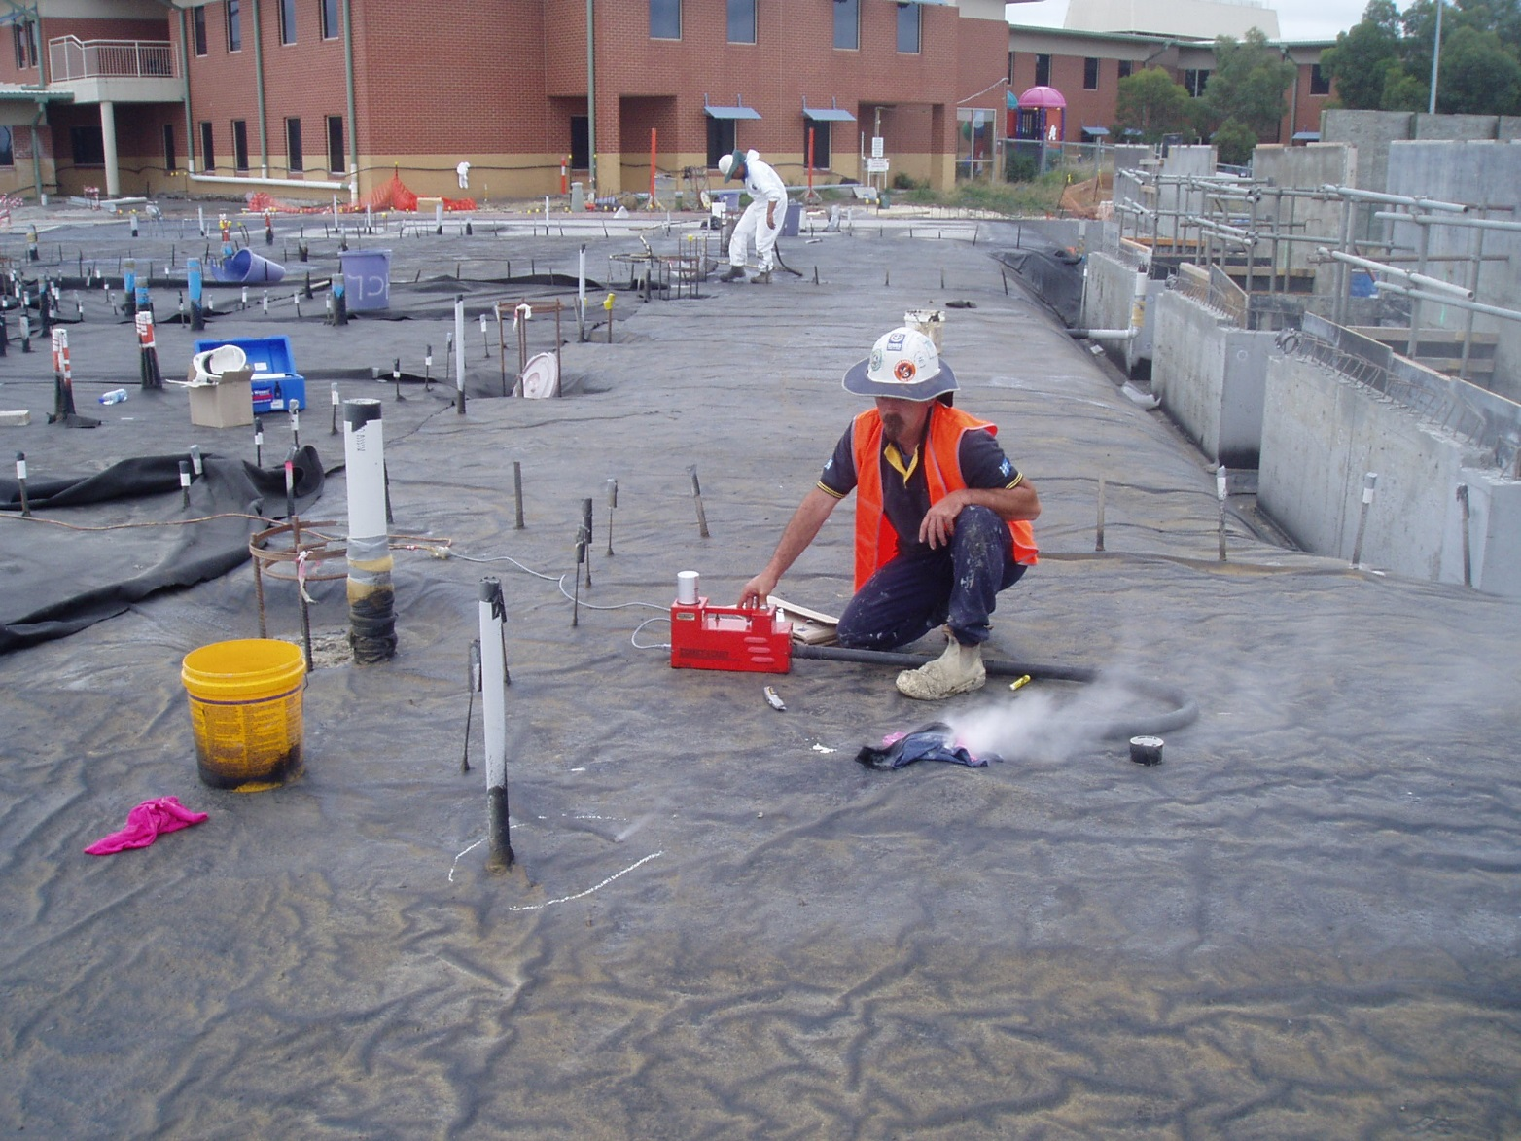
Vapor Intrusion Barrier

Slide 43
Questions ?

